Slide 1



Alpha Tech Academy
<Profy Management>

Slide 2
TEAM LIST
M Ilham Farrohi
Anbar Firdaus

Slide 3

PROJECT PREPARATION - Analisa Project

Slide 4

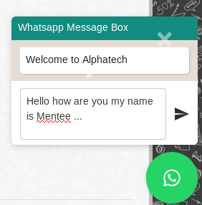
PROJECT PREPARATION - Analisa Project

Slide 5
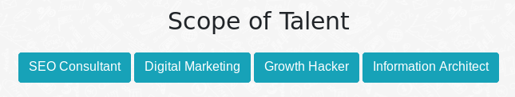

PROJECT PREPARATION - Analisa Project

Slide 6
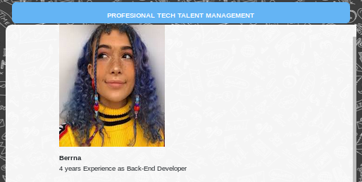

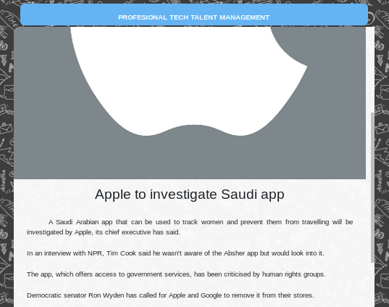
PROJECT PREPARATION - Analisa Project

Slide 7
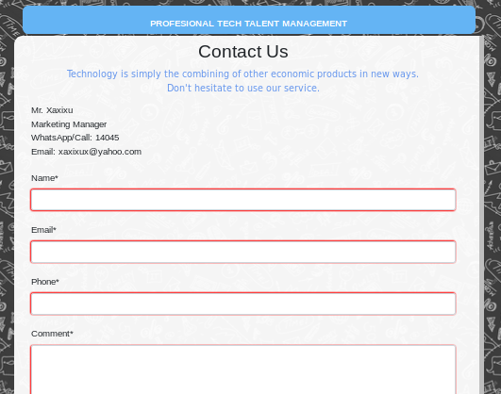


PROJECT PREPARATION - Analisa Project

Slide 8
PROJECT PREPARATION - Database Model
News
title
created_date
content
content
picture
our_talent
title
created_date
description
picture
contact_us
name
created_date
e-mail
phone
comment

Slide 9
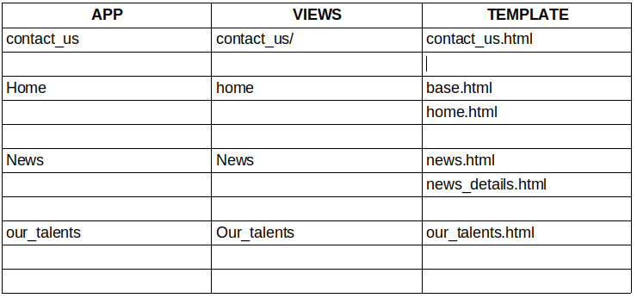
PROJECT PREPARATION - Views & URL

Slide 10


PROJECT PREPARATION - Extra Preparation

Slide 11
PROJECT DEMO

